Slide 1
Supporting evidence use and building capacity:
3ie Policy Windows
Fides Borja
6th M&E Philippines Network Forum
06 December 2016

Slide 2


What is 3ie? How is it filling gaps?
An international grant-making NGO that funds the production of rigorous evidence to improve the effectiveness of development policies and programmes
Established by donor consortium 8 years ago
Main office in Delhi with offices in Washington, London

Slide 3
What are some of 3ie’s tools?
IE Grant Windows
  Open, Thematic and Policy Windows
Synthesizing Evidence
  Systematic Reviews
  Evidence Gap Maps
Supporting Evaluation
  Advice
  Replication and Registry
  Bursaries to build capacity
135 IEs
30 SRs
10 Reps

Slide 4
Examples of IEs that have had great impact
A youth wage subsidy experiment for South Africa (2014)
Improving Gujarat’s industrial pollution inspection standards (2012)

Slide 5
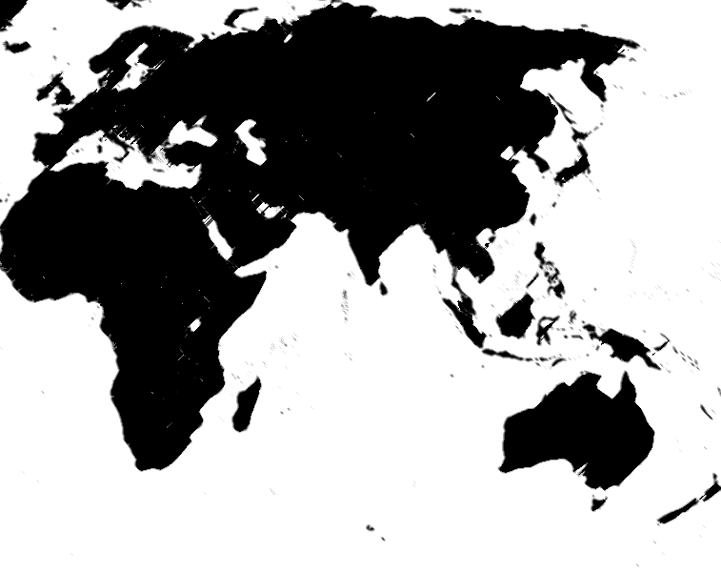
Country Policy Window
WEST AFRICA*
Nepal*
UGANDA
PHILIPPINES

Slide 6
Philippine Country Policy Window
Steering Committee chaired by NEDA
Funded by DFAT, Govt. of Australia
Objectives:
Four IEs
In-country delivery of CLEAR course
Demand generation workshops
Policy influence clinic
Inception workshops for policy makers on using Impact Evaluations

Slide 7
Philippine Country Policy Window Grants
Department | Program(s) | Research Team | Completion Date
Department of Labor and Employment (DOLE) | Special Program for the Employment of Students (SPES) | Innovations for Poverty Actions Philippines (IPA) | April 2017
Department of Social Welfare and Development (DSWD) | Sustainable Livelihoods Program (SLP) | Philippine Institute for Development Study (PIDS) | March 2019
Office of the Presidential Advisor on the Peace Process (OPAPP) | PAMANA’s Indigenous People - Community Driven Development (IP-CDD) | University of Mannheim | June 2019
Supreme Court (SC) | Reform program to be determined | IPA-PIDS | June 2019

Slide 8
Lessons Learned
Implementation Issues: what is happening on the ground
Buy-in and engagement at all levels (policy-makers, implementers and evaluators)
Timeliness: Results when policy-makers need it
IEs as part of a broader evaluation system
Accessible and useful IEs to a wide range of audiences

